Slide 1






Automate your way to privileged access security
Joe Garcia, DevOps Security Engineer, CyberArk
infamousjoeg

Slide 2

CyberArk’s Mission
Provide a modern approach to IDENTITY SECURITY anchored on privilege to protect against advanced cyber threats

Slide 3

Agenda
Bridging Islands of Security
Unique Credentials & Keys
Using Custom Credentials
Connect to many unique remote endpoints
How you can get started
Notes:
SESSION ABSTRACT:
Humans aren't perfect. We don't follow code and have many things going on at once. An alarming number of organizations take on manual tasks managing credentials and onboarding secrets, but too frequently human error or absence of process results in security vulnerabilities. Those vulnerabilities simply scale and unnecessarily expose the enterprise. This session provides guidance for improving the security of automation processes while using Ansible, increasing agility and reducing stress, all while establishing a high level of security. You'll leave with tools to start strengthening the security of Ansible processes, including:
- Solve the question of patch management for hundreds of endpoints each containing a unique credential/key
- Use of popular enterprise and open-source secrets management solutions to secure Ansible
- Use of Ansible Automation Platform's Secret Management Systems to remove SSH private keys and root account passwords and provide them as Machine credentials just-in-time.

Slide 4


Bridging Islands of Security
01
cyberark.com

Slide 5






What is an Island?
Every service in your pipeline.

Slide 6
What is an Island of Security?
Every service in your pipeline has a way to store secrets.
Key Vault
Credentials
Secrets
Secrets Manager
Secrets
Credentials

Slide 7

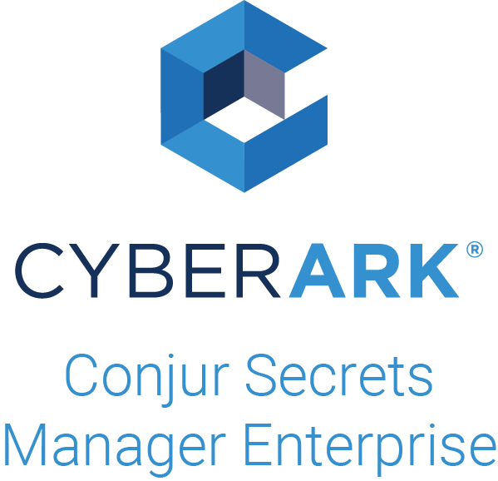
How can we bridge Islands of Security?
Centralized service for secrets management.
Key Vault
Credentials
Secrets
Secrets Manager
Secrets
Credentials

Slide 8

Unique Credentials & Keys
02
cyberark.com

Slide 9



Before Centralized Secrets
An attacker’s paradise.
Single Super User Password
Static Privileged Identity
Scattered Access Audit Logs
Solarwinds123
Qwerty123
Hunter2
Both Human & Non-Human
Human is typically local (root, Administrator)
Non-human for applications
Must analyze logs from platform or application to understand who or what accessed
No oversight on use of Privileged Identities

Slide 10



After Centralized Secrets
Paradise lost.
Unique Passwords & Keys
Just-in-Time Privileged Access
Centralized & Complete Audit
Passwords automatically rotated after one-time use
Private keys automatically managed & Public keys updated on endpoint
No disclosure of password or key to human for endpoint connection
Applications request secrets as needed instead of storing static
Audit for all access to every secret and privileged identity can be anaylze in a single source
Allows for global alerting for Incident Response

Slide 11

Using Custom Credentials
03
cyberark.com

Slide 12
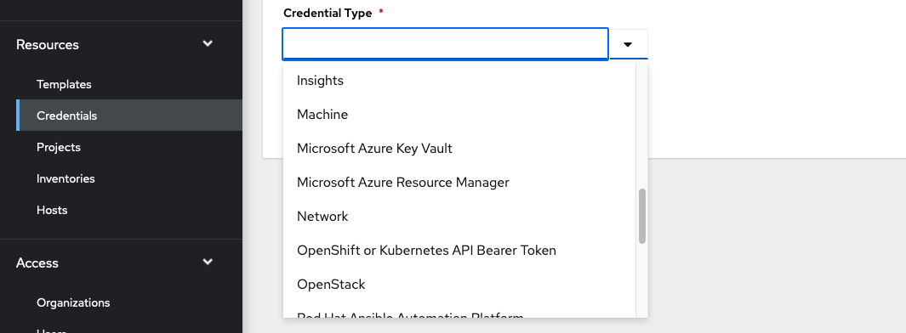
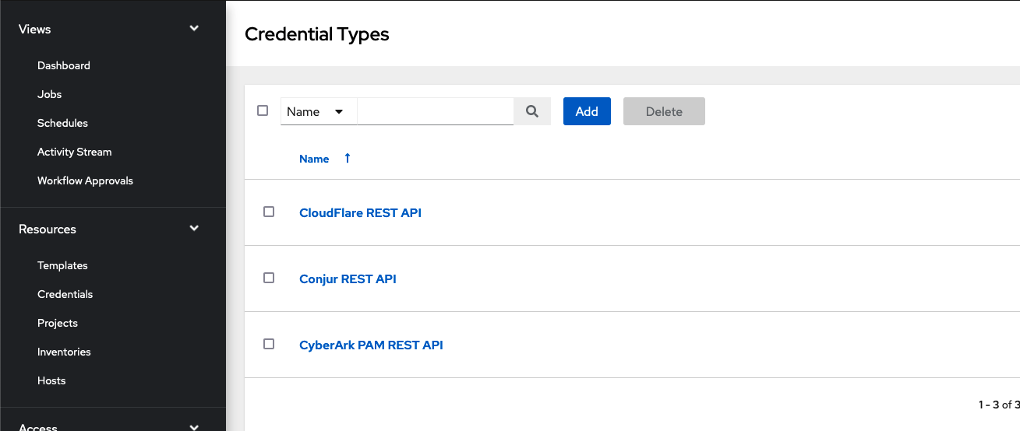
What is a Custom Credential Type?
An under-used feature of Ansible Automation Platform.
Extend credential types capable of being injected into execution environments.
Default Credential Types
Custom Credential Type
Most used credential types
Available out of the box
Extend credential support to additional services
Requires knowledge of service authentication requirements
Injects credential metadata using environment variables

Slide 13
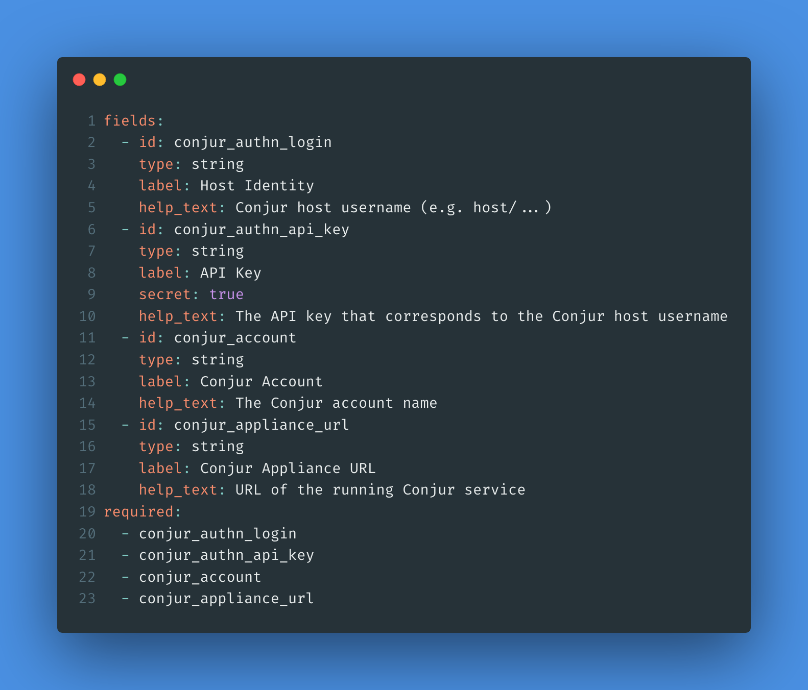
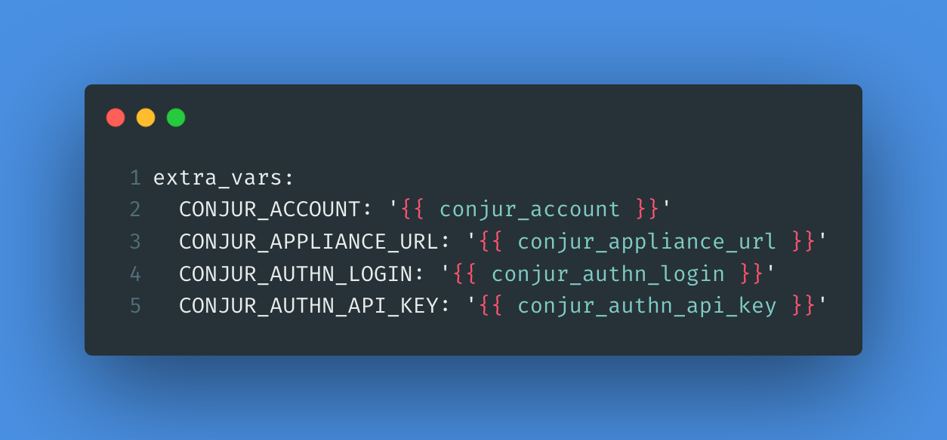
Create a Custom Credential Type
Let’s create a custom credential type for Conjur’s REST API.
We can use this later when retrieving unique private keys for remote endpoint connections.

Slide 14
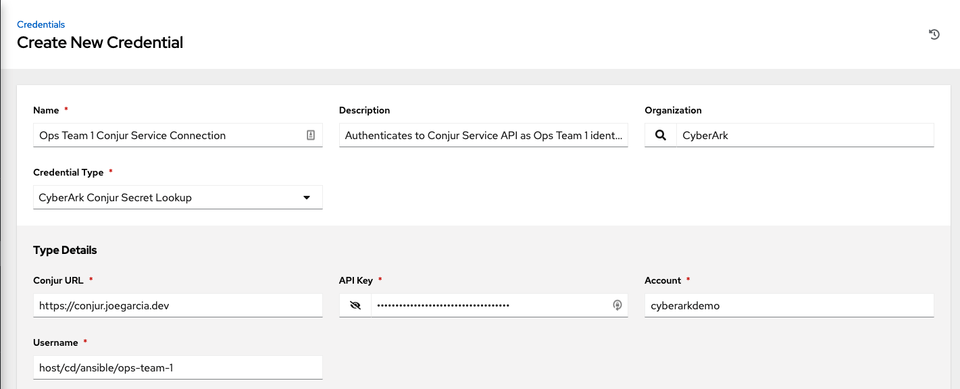
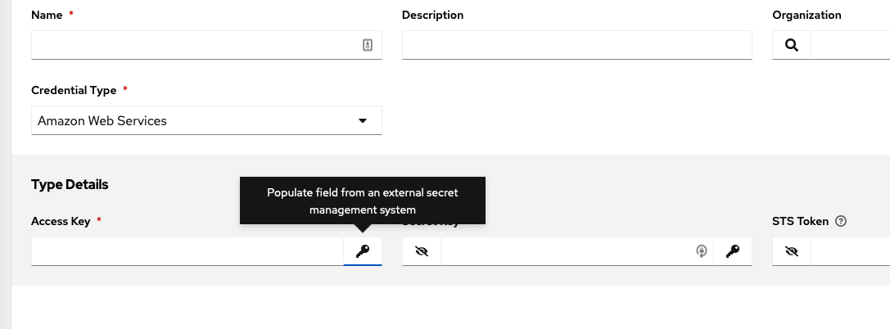
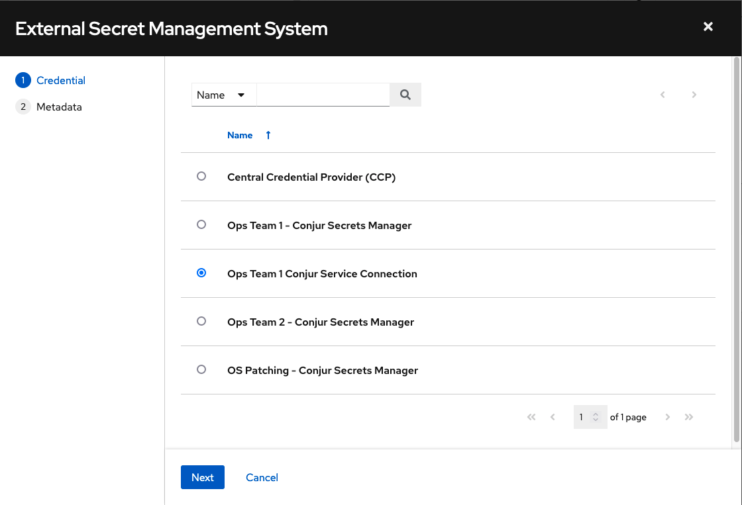
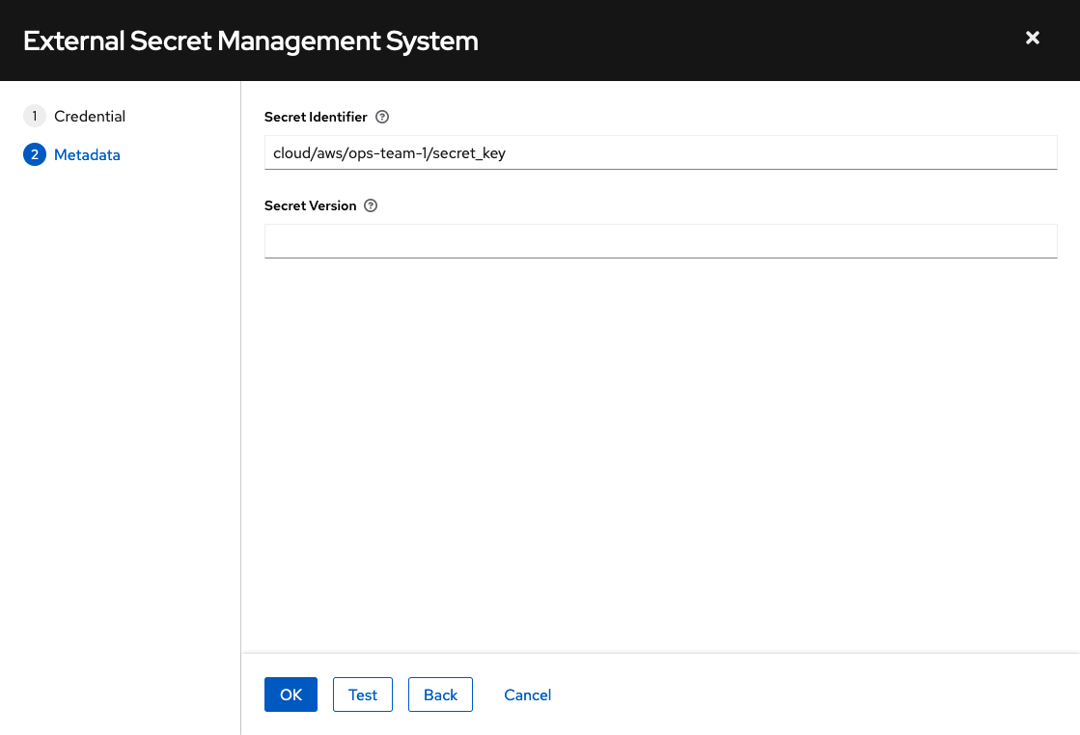
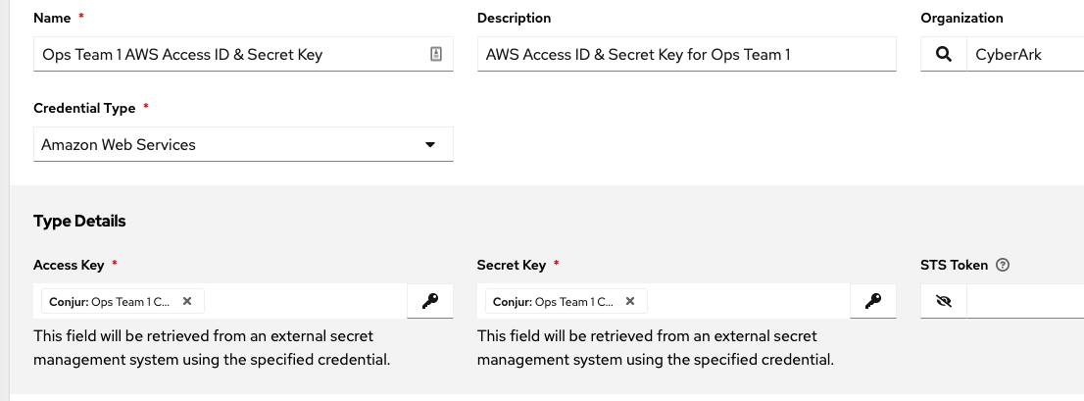
Using Secrets Management Systems
Step 1 – Create Service Connection
Step 2 – Create Credential & Link Lookup
Create a credential that holds the connection information needed by Ansible Automation Platform to the Conjur Service API.
Create new Credential using proper Type
Click Key button to access Secret Management Systems
Select External Secret Management System
Provide secret metadata for retrieval

Slide 15

Connect to many unique remote endpoints
04
cyberark.com

Slide 16
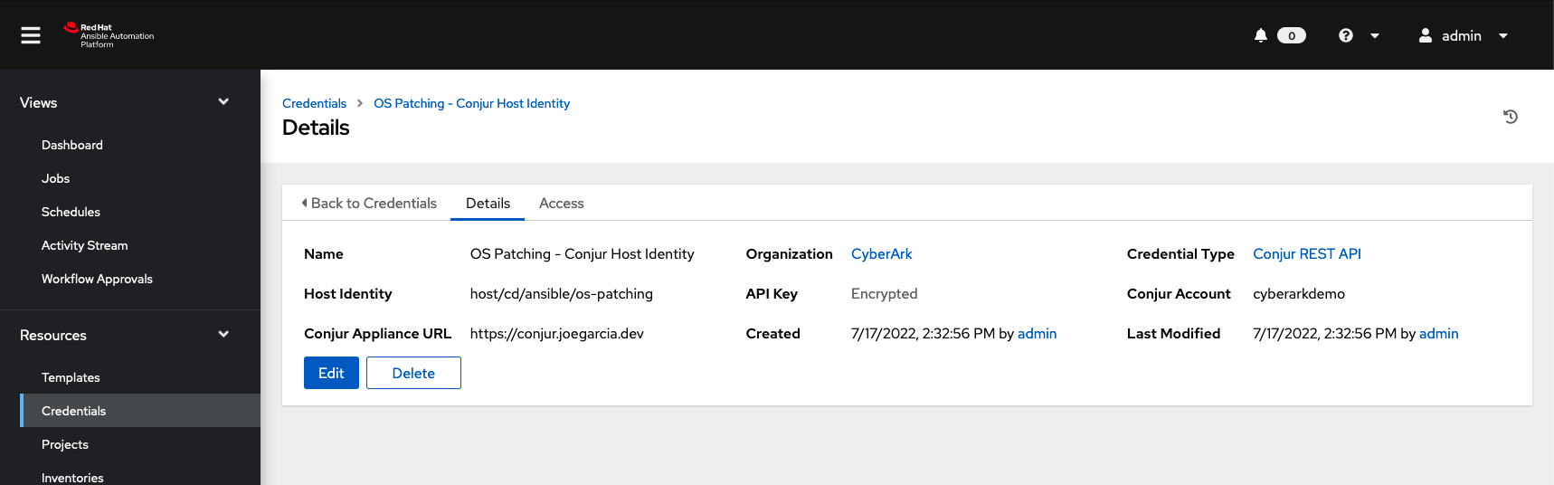
Create Conjur REST API Credential
Ansible will need to provide a Conjur Identity for authentication.
The values provided in this custom credential type will allow us to create configuration and identity files in the next step.

Slide 17
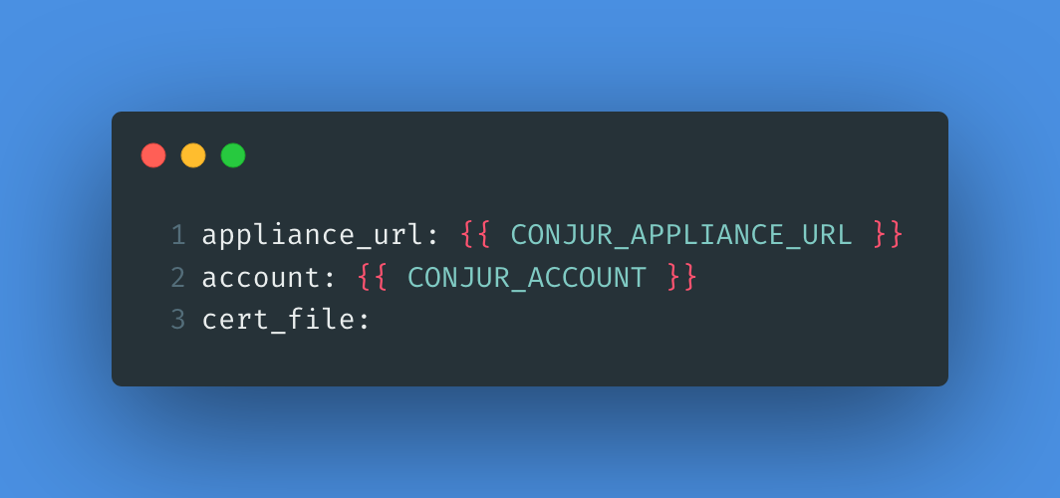
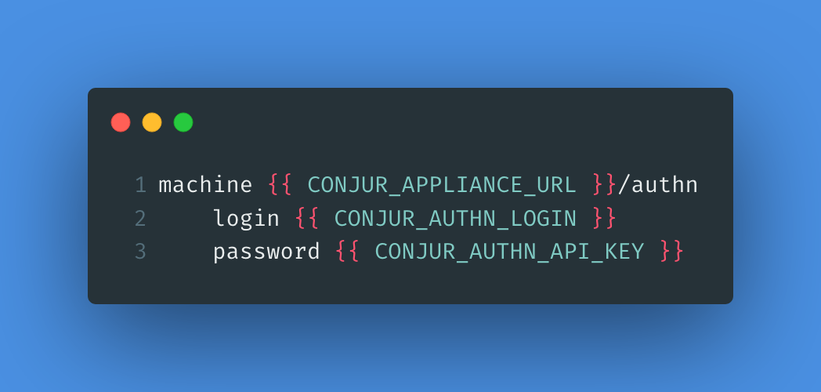
Setting Conjur Host Identity
Conjur’s conjur_variable Lookup Plugin needs to authenticate.
Setting configuration and identity files on-demand in the execution environment ensures short-lived persistence.
templates/conjur.conf.j2
templates/conjur.identity.j2

Slide 18
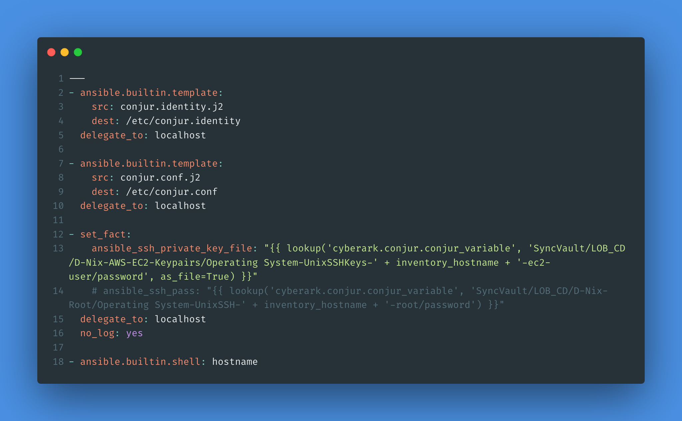
Retrieving Unique SSH Private Key
Each hostname has a unique private key for authentication.
We’ll need a naming convention that includes the hostname so we can use the `inventory_hostname` variable to dynamically add it.
tasks/main.yml

Slide 19

Post-Deploy Security Considerations
Cleaning up after shipping out.
Execution environment is completely removed.
No leftover configuration or identity secrets.
No cached private key from SSH connection on Ansible Controller.
Unique SSH Private Keys and/or root passwords means no attacker lateral movement.
SSH Private Key and/or root password used during job can be rotated automatically.
This could be triggered as a post-action in the playbook or scheduled via CyberArk policy.

Slide 20

How you can get started
05
cyberark.com

Slide 21






Start for free, right now!
Secure your Ansible automation jobs when you get back.
Conjur Open Source
CyberArk on Ansible Galaxy
Ansible Playbook Examples
https://conjur.org
https://galaxy.ansible.com/cyberark
https://cybr.rocks/ansiblefest2022

Slide 22
Thank You

